Slide 1
Working with a contractor to deliver a Shiny dashboard
Iris Oren
Iris.Oren@gov.scot
Energy and Climate Change Analysis
Office of the Chief Economic Advisor

Slide 2
The business need
Climate Change Plan
Plan for Scotland to meet GHG targets (net zero by 2045)
Finds least cost solution for Scotland to meet climate change targets
Thousands of input and output variables
Challenge to QA data and results
Diverse stakeholders from sectors across gov – differing questions
Querying model for bespoke results – time consuming for modelling team
Scottish TIMES Model

Slide 3
The business need
Stakeholders
Scottish TIMES Model
Interactive
R-Shiny dashboard
Results
Feedback for next round of modelling
Benefits
Increase stakeholder engagement
Increase trust in model
Increase model robustness
Allow users to explore full richness of model solution
Free time for TIMES team to focus on modelling
Challenge
Small TIMES team
1 member with R-coding experience
Solution: Procured dashboard

Slide 4
Procurement
Business case for dashboard
Invitation to tender:
How will we work together?
How will work be divided between SG Analysts and Contractor?
What do we need?
Stakeholder engagement to learn user needs
Develop PoC
Feedback from PoC to final product
Ensure that SG can host internally
Include accessibility
Plan for ensuring product can be maintained
Include handover requirements in ITT
Who to invite to tender?
DataLab identified potential bidders
Three shortlisted

Slide 5

Development
Five month project
Forecast Team:
1 Project manager,
1 Developer (IT) – Shiny
2 Data engineers/support. Hosting, stakeholder engagement, documentation
SG:
1 Analyst (IO) – Data preprocessing
Non-disclosure agreement setup

Slide 6
Development
May 2022
June 2022
July 2022
Sep 2022
IT + IO
PoC
IT + IO
Full product
Live dashboard
Stakeholder workshops
Product specification document
Forecast + SG
prioritise
requirements
Data eng + AWB
Hosting solution

Slide 7
Project management
Agile project management
Tools:
SG Teams: Forecast added as guests. Day-to-day communication
Version control: Git
GitHub Issue tracking: Log project issues and discussions
Project management: GitHub Project - direct link to code repository

Slide 8
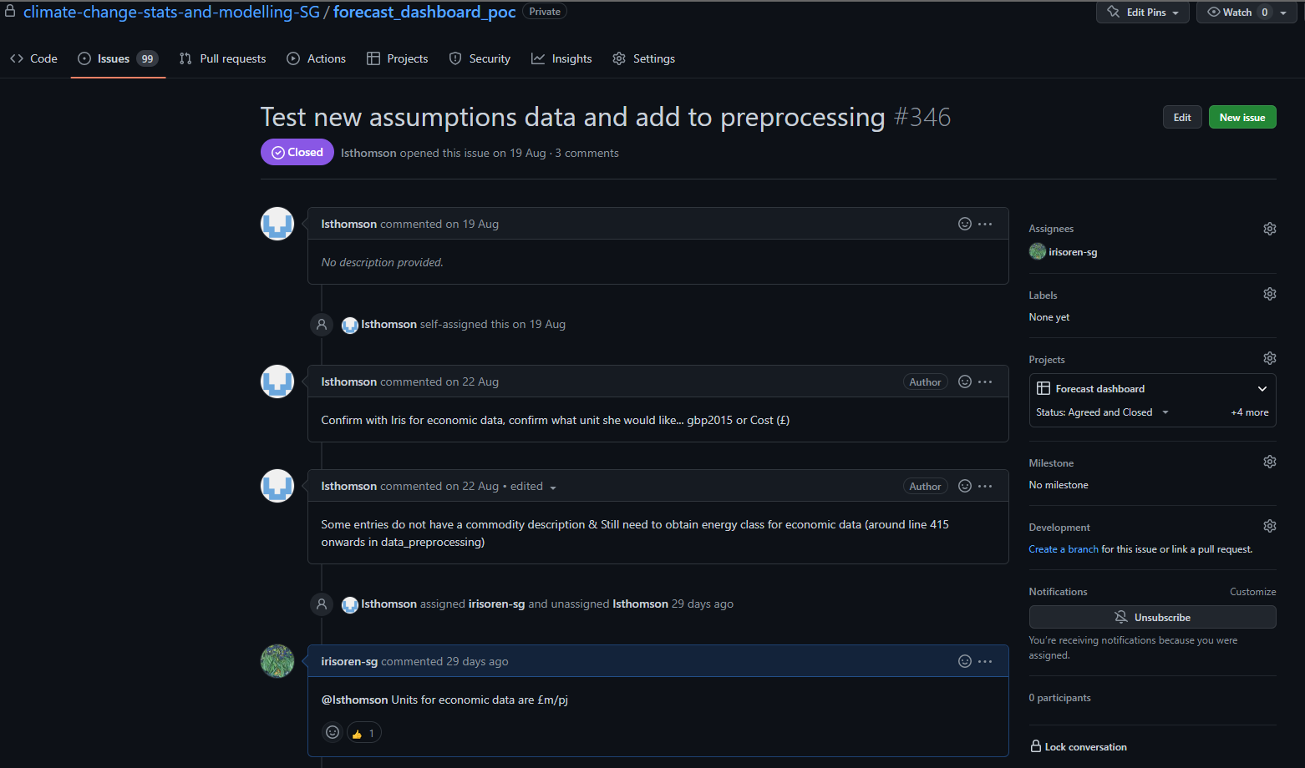
Project management
GitHub Issue tracking

Slide 9
Project management
Agile project management
Tools:
SG Teams: Forecast added as guests. Day-to-day communication
Version control: Git
GitHub Issue tracking: Log project issues and discussions
Project management: GitHub Project - direct link to code repository

Slide 10
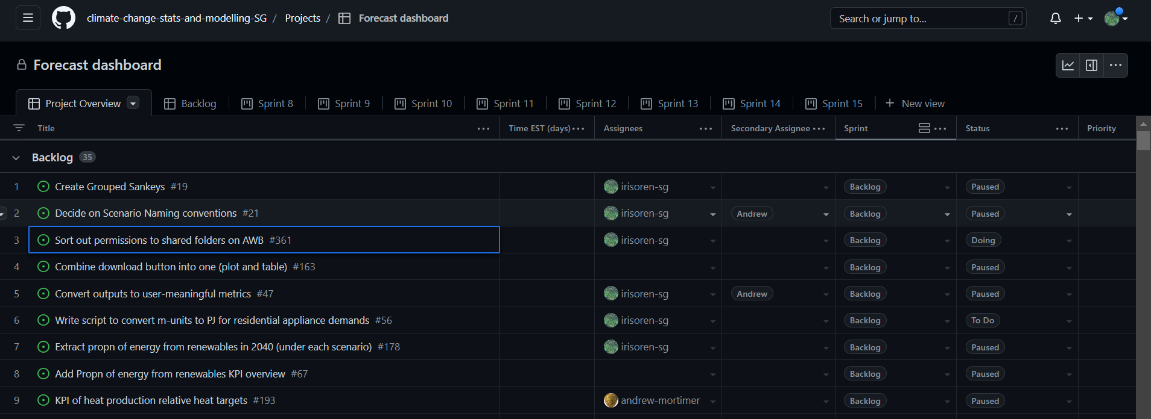
Project management
GitHub Project feature

Slide 11
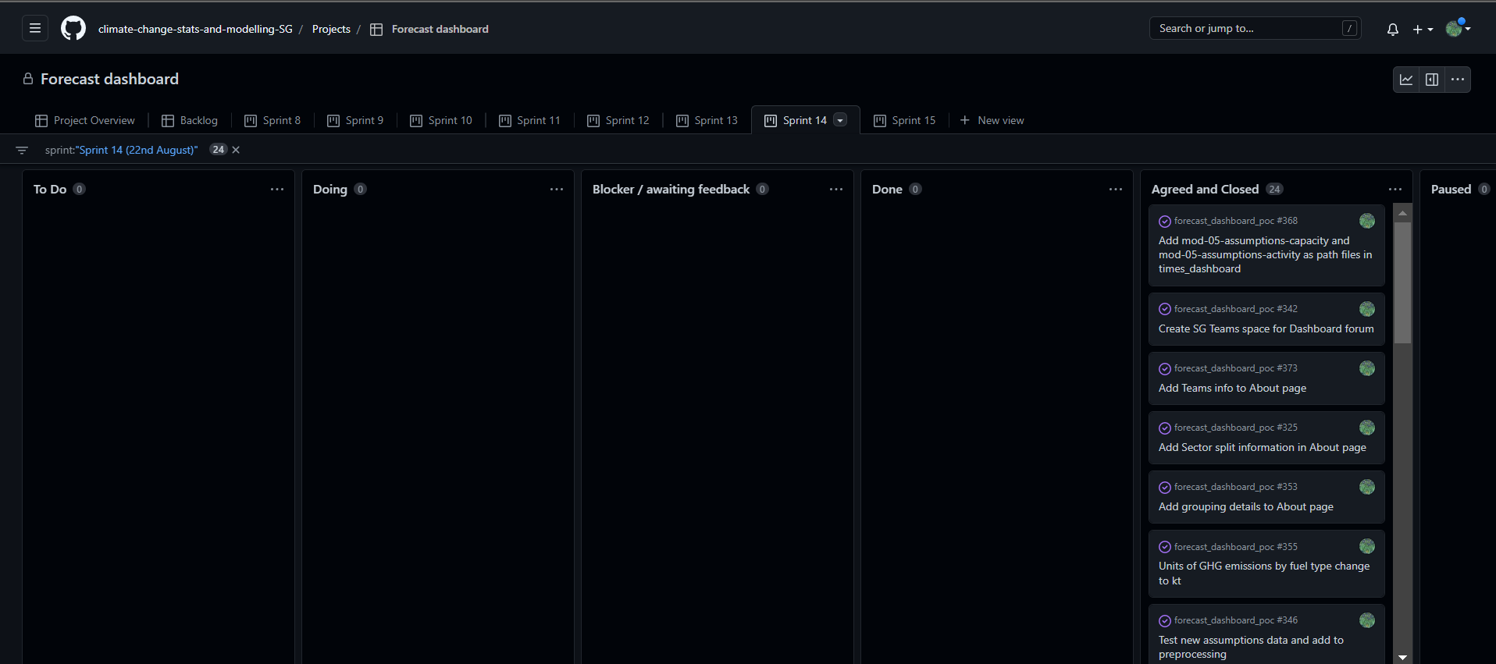
Project management
GitHub Project feature

Slide 12
Hosting
SG Analytical Workbench Shiny server
Forecast access AWB through own VPN
Support from AWB team to deploy
Dashboard accessed through secure login – individual usernames and passwords

Slide 13

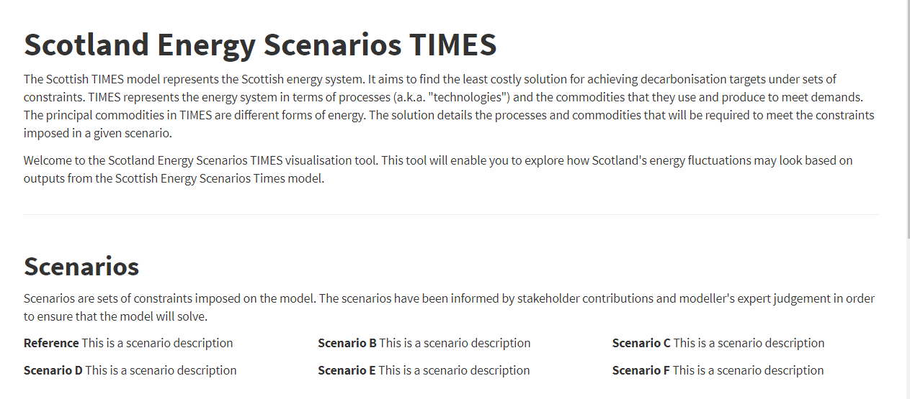
The product

Slide 14
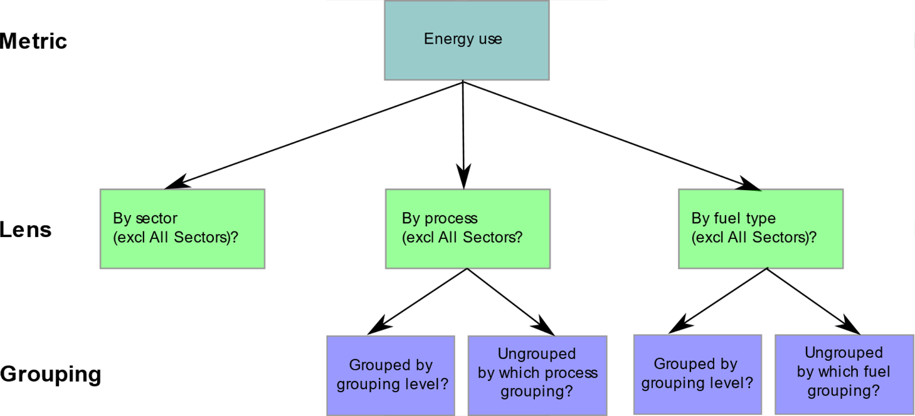
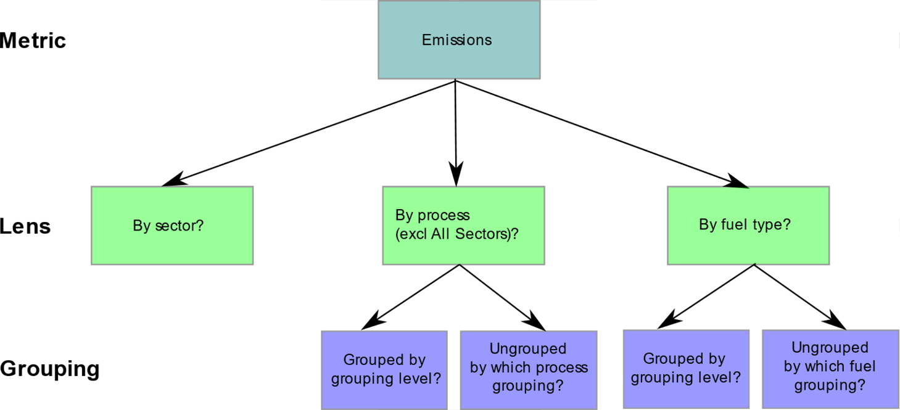
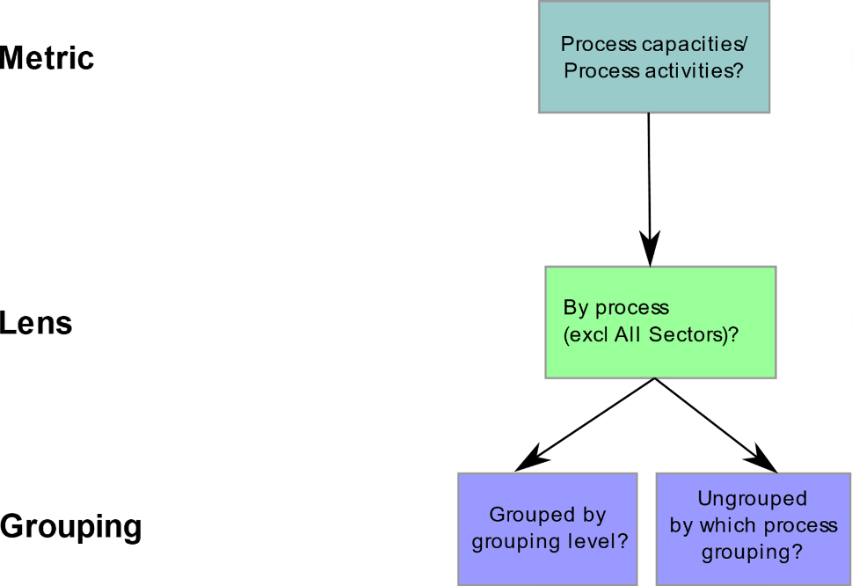
The product
Detailed view flows

Slide 15
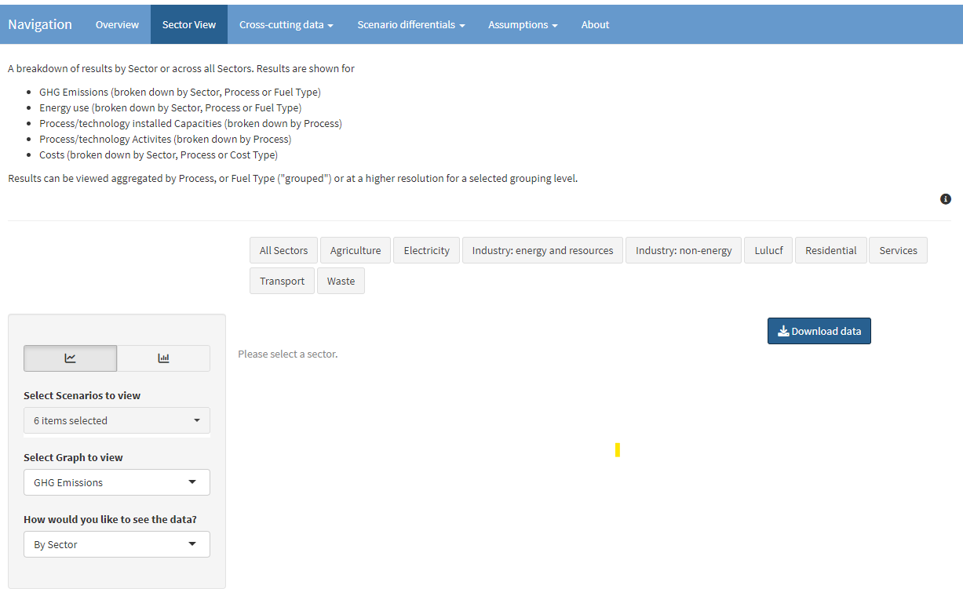

Slide 16
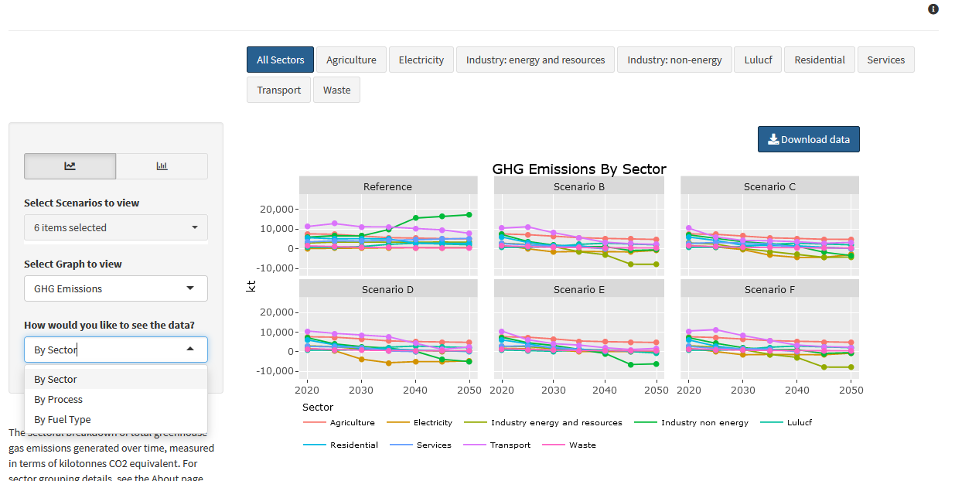

Slide 17
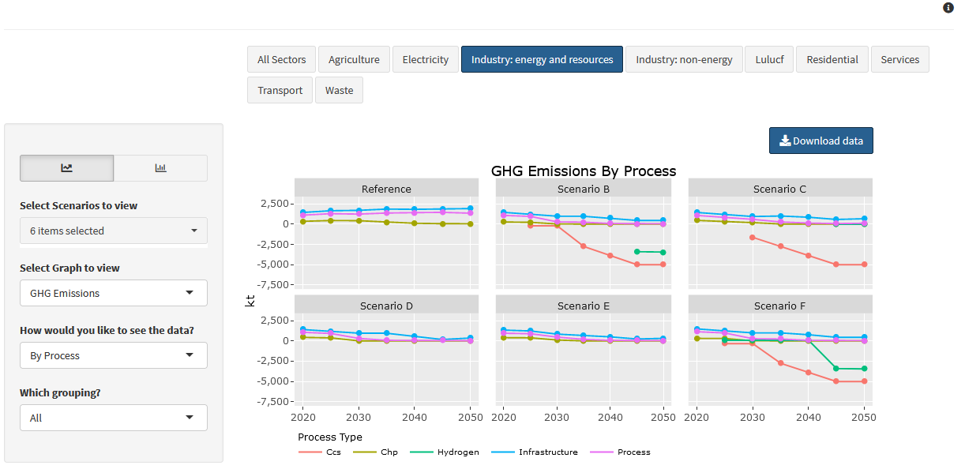

Slide 18
Handover
Commented code
Full documentation of current dashboard
Dependencies mapped out
Instructions for updating, adding features
Details of optional features left in repository
Sign-off by SG
Editable documentation to allow SG to continue development

Slide 19
Benefits
Deliver a complete product under time constraints
Amplify SG resource
Learning for SG analyst - working as part of a software development team

Slide 20
Lessons learned
Prioritise essential features (there will always be nice-to-haves)
Stakeholder workshops useful – but limit size and number
Organise code/project from the start to allow hosting
Accept that you will run into issues.
Agile principles allow responsiveness
Communication made project success (build this into ITT)

